Slide 1
Downloading VS Code
SISMID Lab Supplemental Material
July 22 through July 24, 2026
A Human – AI Teaming Approach to Infectious Disease Modeling

Slide 2
Roadmap
This slide deck provides a step-by-step walkthrough of downloading Visual Studio Code (VS Code) onto your local system.
If you run into issues, please first work with the AI of your choice to troubleshoot.
If you continue to have issues, please reach out to Amanda Bleichrodt (ambleic@clemson.edu).

Slide 3
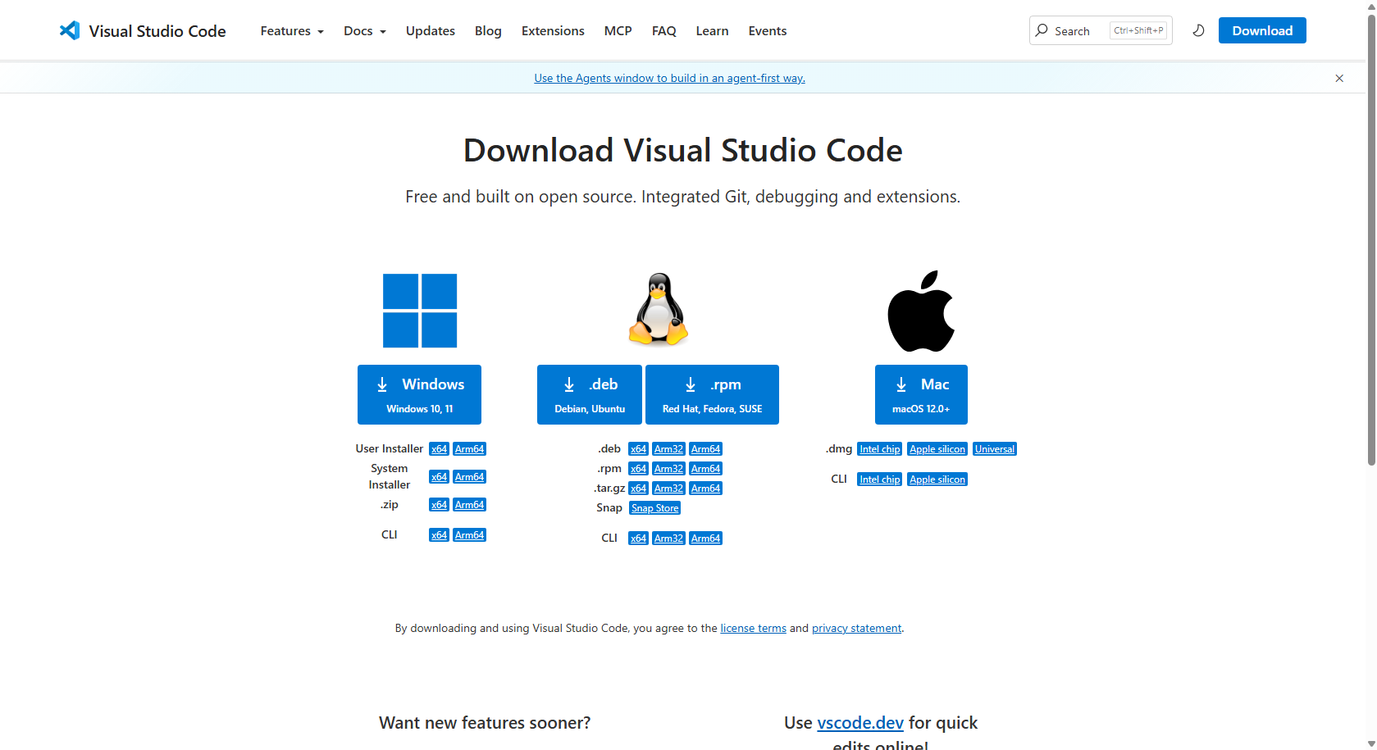
Step 2: Install the appropriate VS Code for your operating system.
Step 1: Navigate to the VS Code webpage.
https://code.visualstudio.com/download

Slide 4
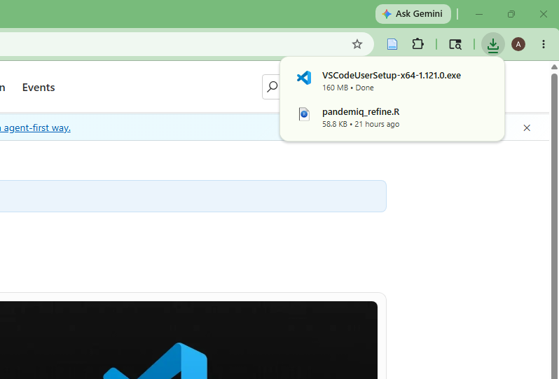
Step 3: Open the newly downloaded VS Code set-up wizard.

Slide 5
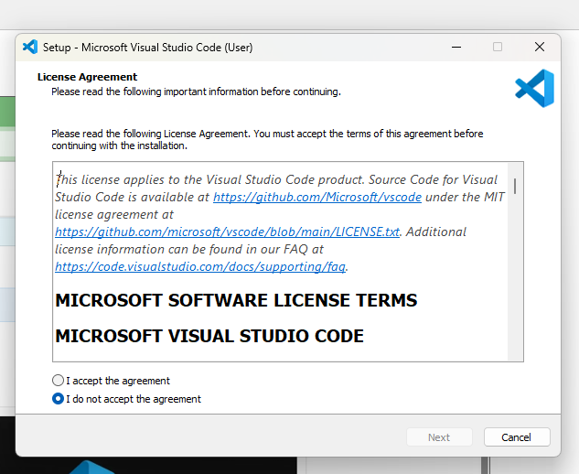
Step 5: Click “Next”.
Step 4: Click “I accept the agreement”.

Slide 6
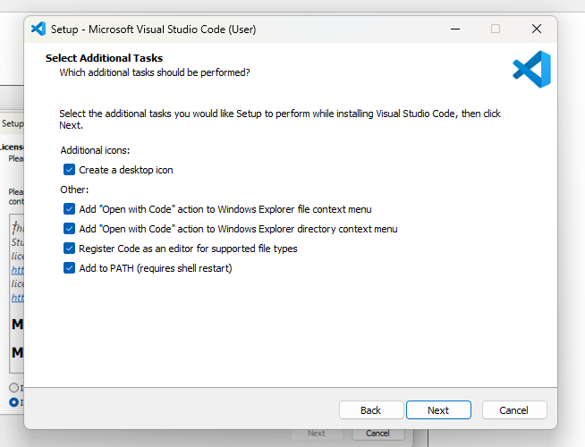
Step 7: Click “Next”.
Step 6: Make sure all additional tasks are selected.

Slide 7
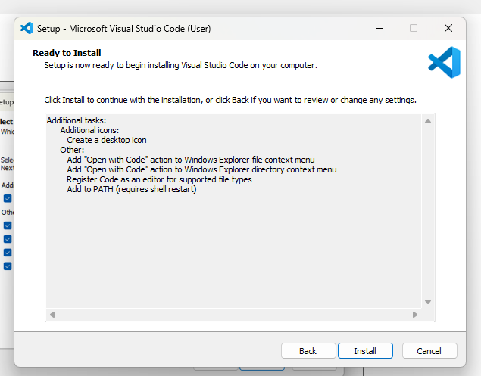
Step 8: Click “Install”.

